Slide 1


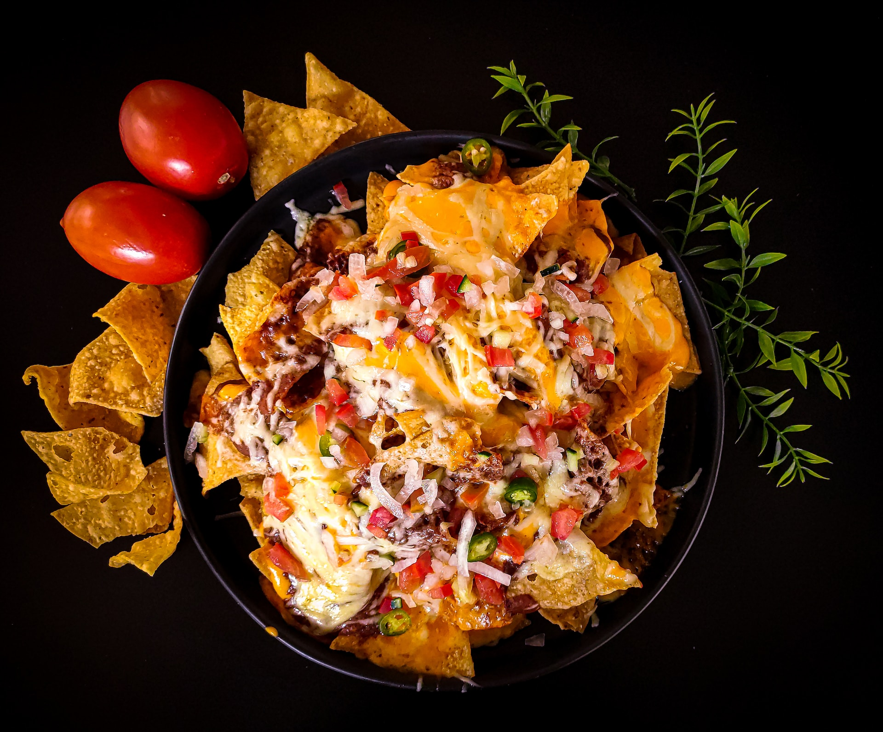
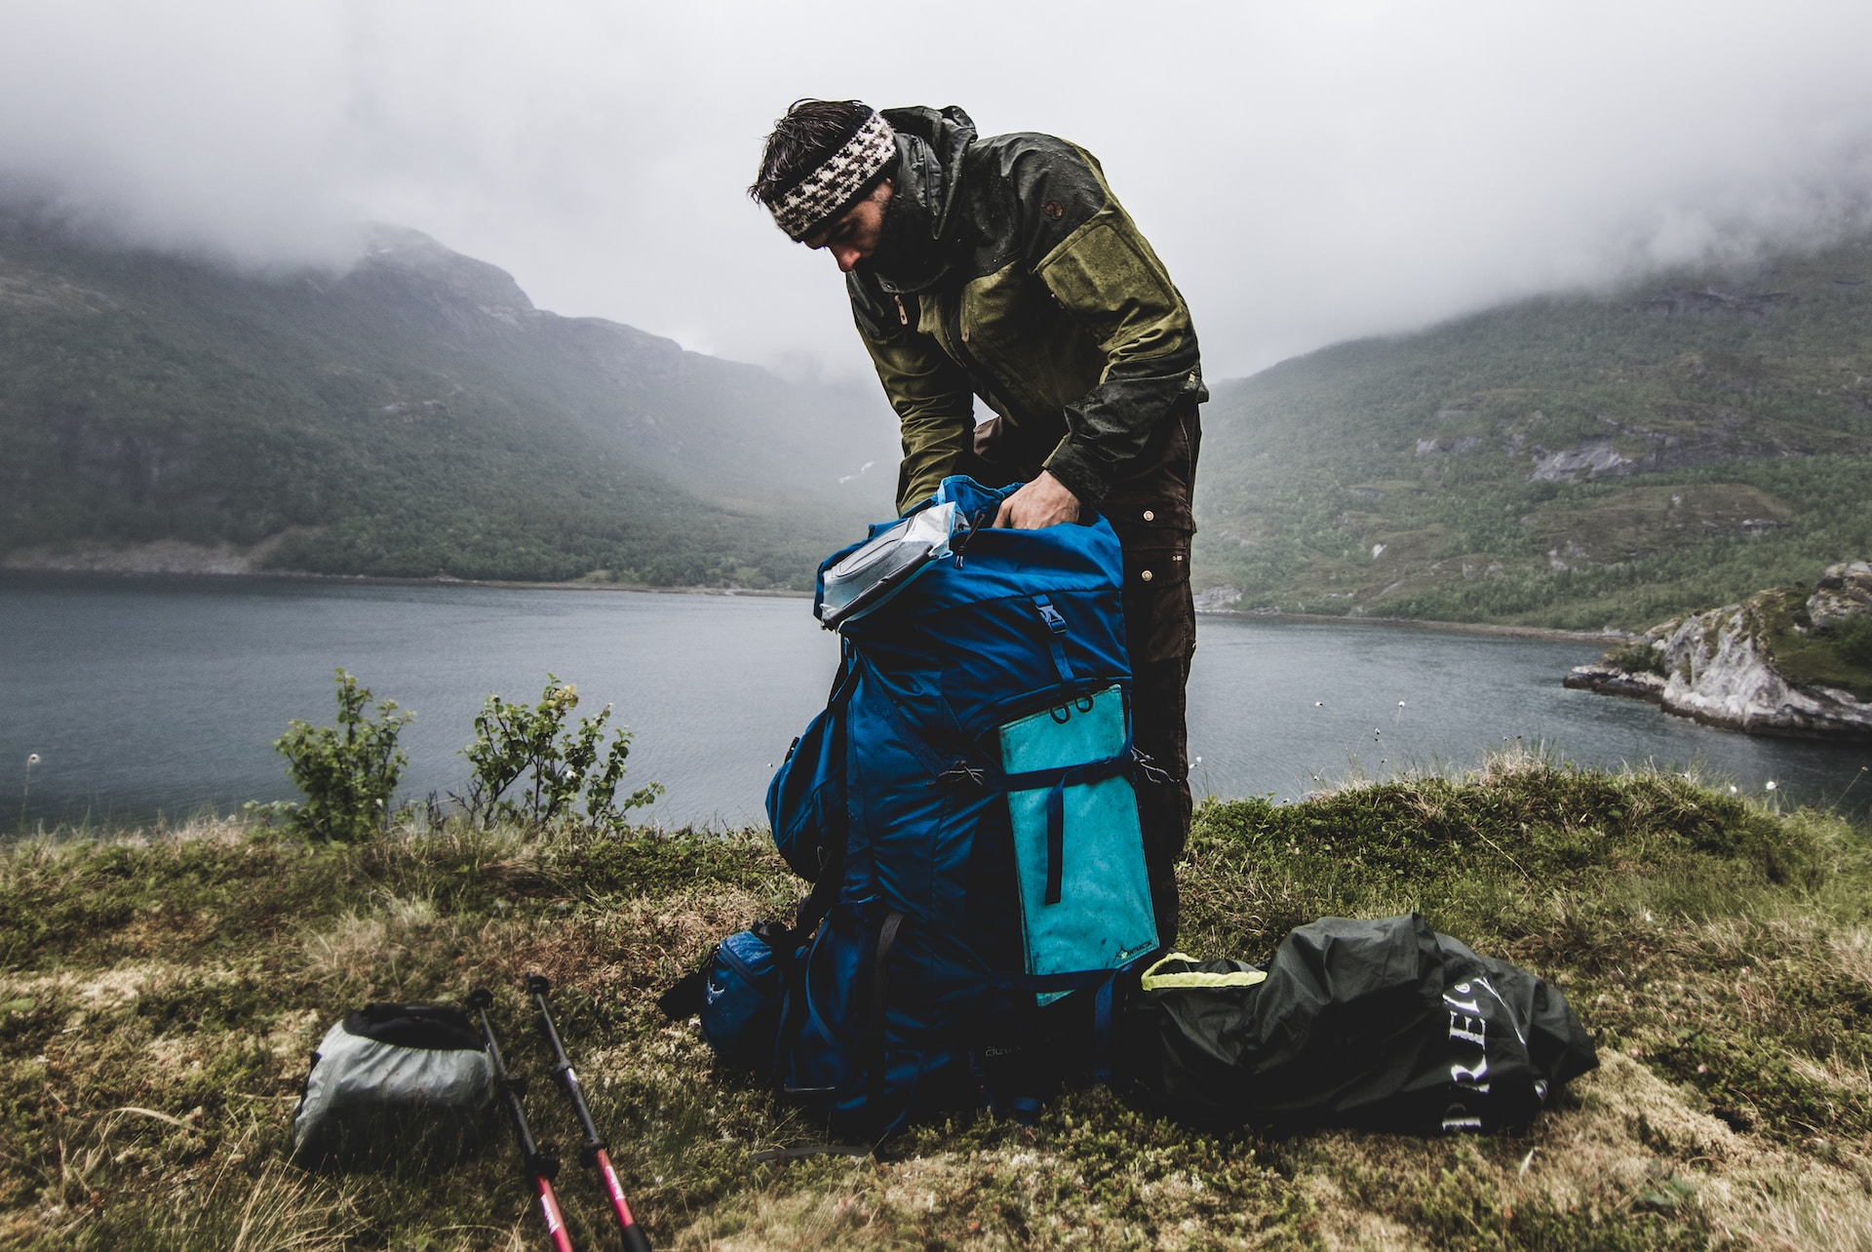
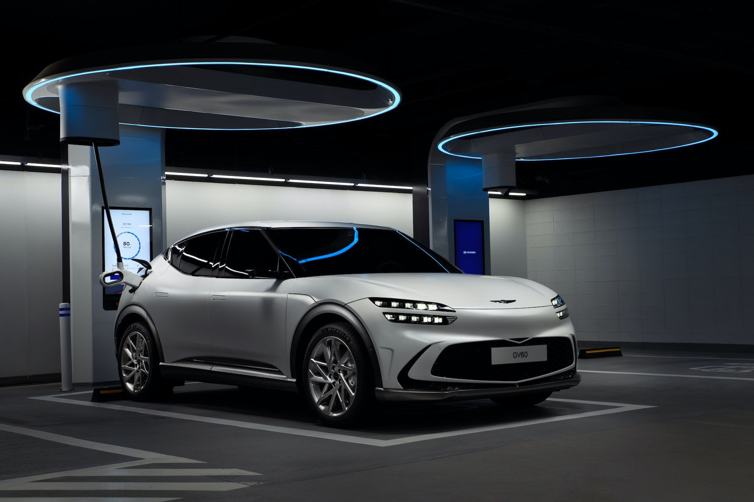
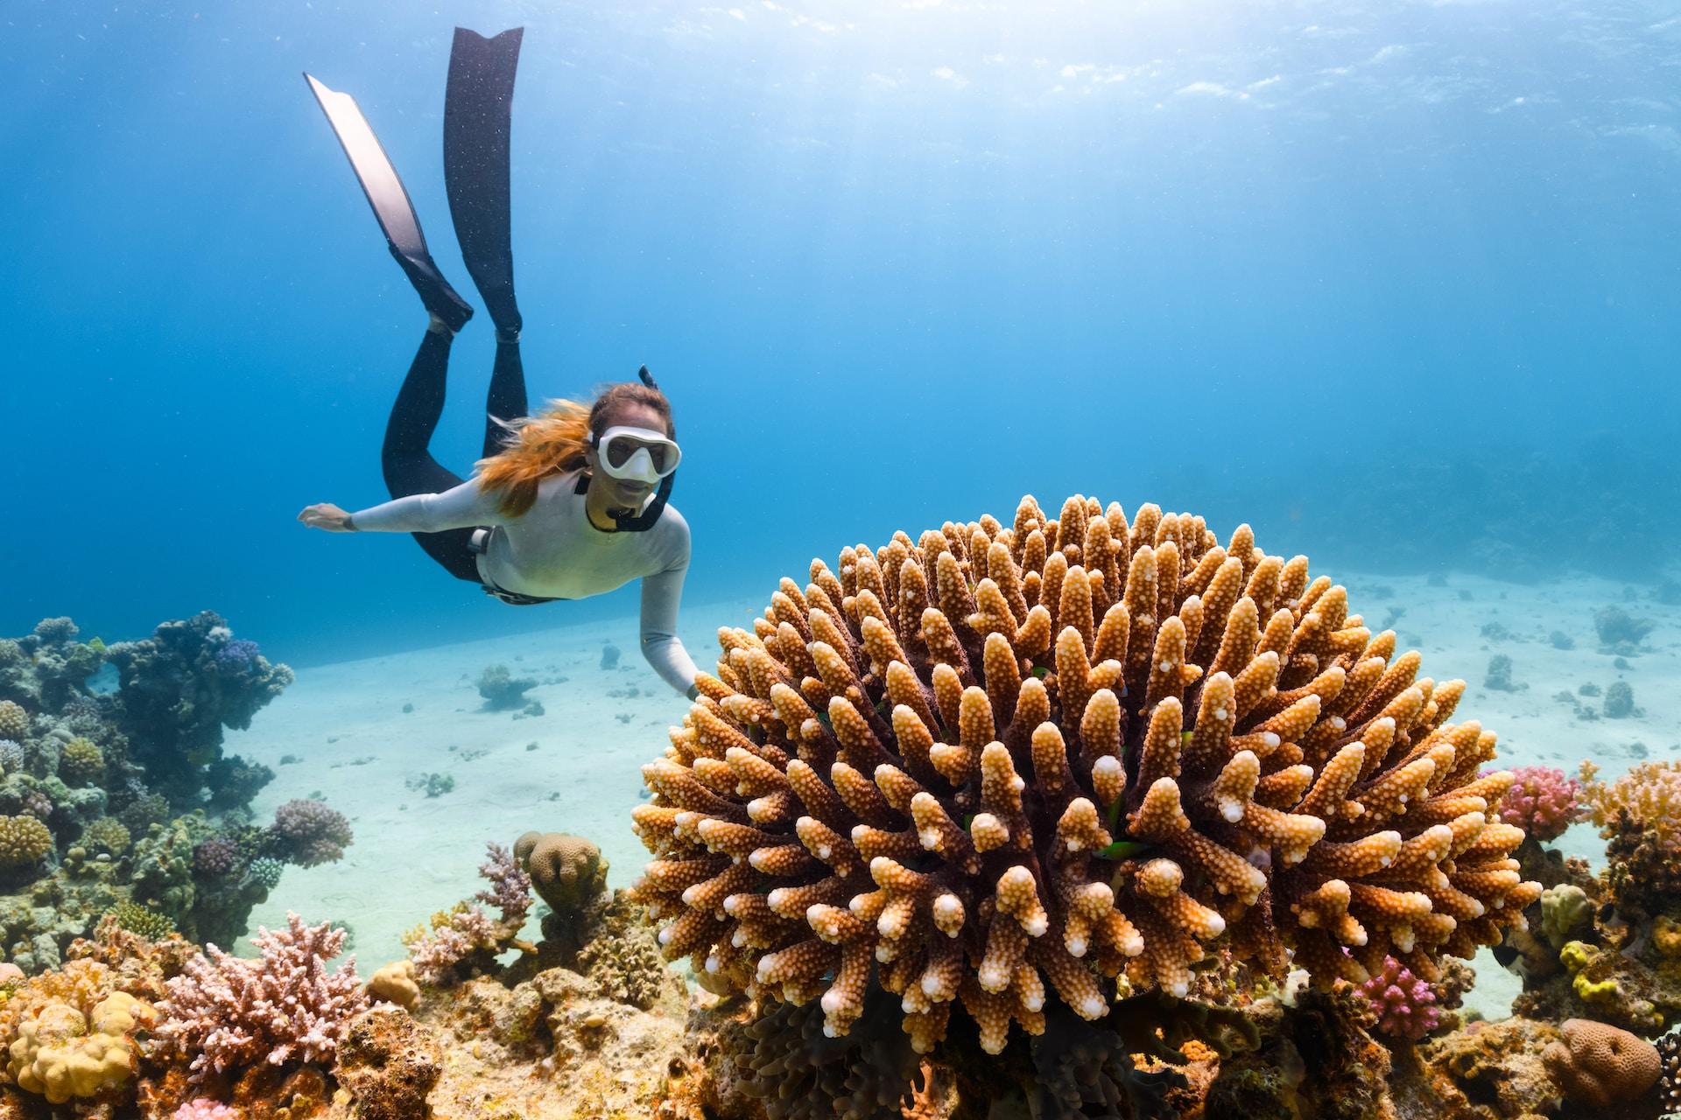
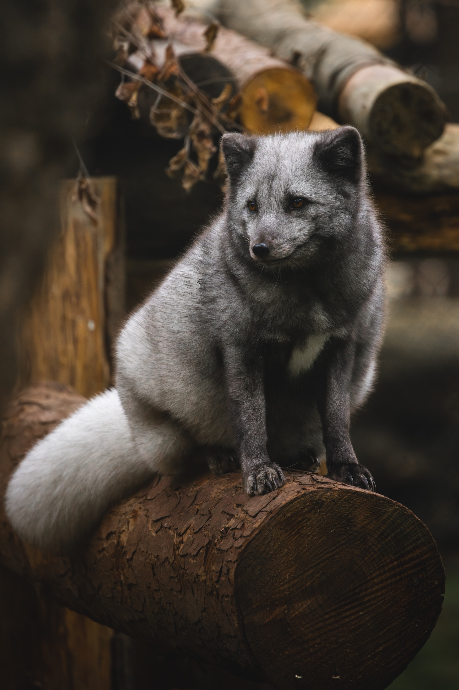
Event

Slide 2



June
Event

Slide 3




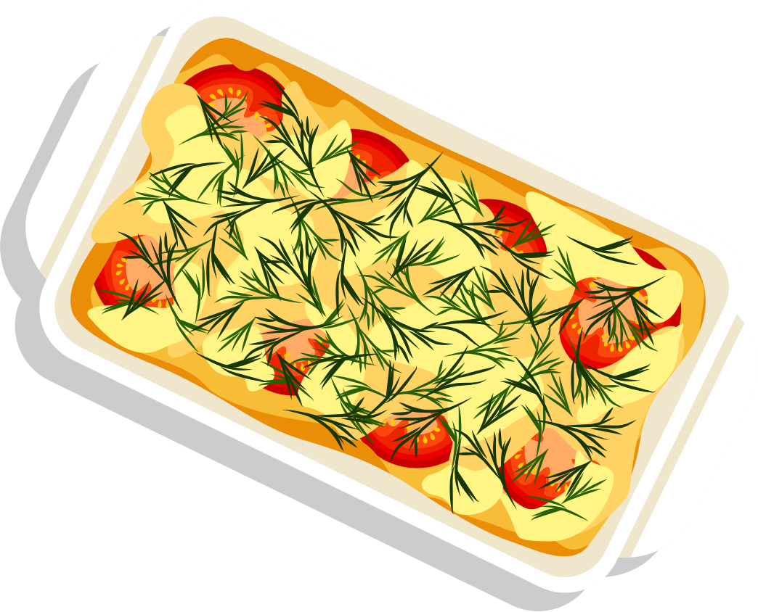

Electrical cars
Finally Someone has put out the efforts to do something new …presenting us the electric car ex- Tesla that has got us a whole bunch of features with embedded auto pilot . I think I m gonna get one (when I have that much money ).
Event

Slide 4


lunch
This is something I surely wanna change in my daily life to maintain my posture and good health.
Event

Slide 5






Hiking
Although I know it’s a boring thing to just climb a damn mountain and see the trees which u can just search on google , but I definitely wanna enjoy it .
Event

Slide 6


Diving
Thank god I m going to get my Learner’s License this year only …Finally I could show off my driving skills (although I don’t know any ).
Event

Slide 7
Event

